Slide 1
KEA (Kubernetes Empowerer to API)
Requirements and analysis model

Slide 2
Product description
The product is a platform for deploying, managing, and scaling machine learning models in a production environment. It's primary purpose is to provide a flexible and secure environment for automating ML processes, including model versioning, request routing, and monitoring. The system integrates with Kubernetes, supports model containerization. The product is designed for developers, ML engineers, DevOps teams, and enterprises that require a stable, scalable, and resilient infrastructure for their ML projects.
Team K8C: Daniel Tsurkan; Gadji Dandamaev; Tsaturyan Konstantin; Smolkin Mikhail
Project repo: https://github.com/fanglores/Advanced-Software-Design
This report: here

Slide 3
Product description
<a short description of the product in a few sentences>
Team: list project members and roles
Repo: browseable link to project rep
Report: a link to this slides within project repo/doc storage

Slide 4

Personas
Name <Persona 1>
<find relevant photo>
<provide description>
Wiki page: <link>
Name <Persona 2>
<find relevant photo>
<provide description>
Wiki page: <link>

Slide 5
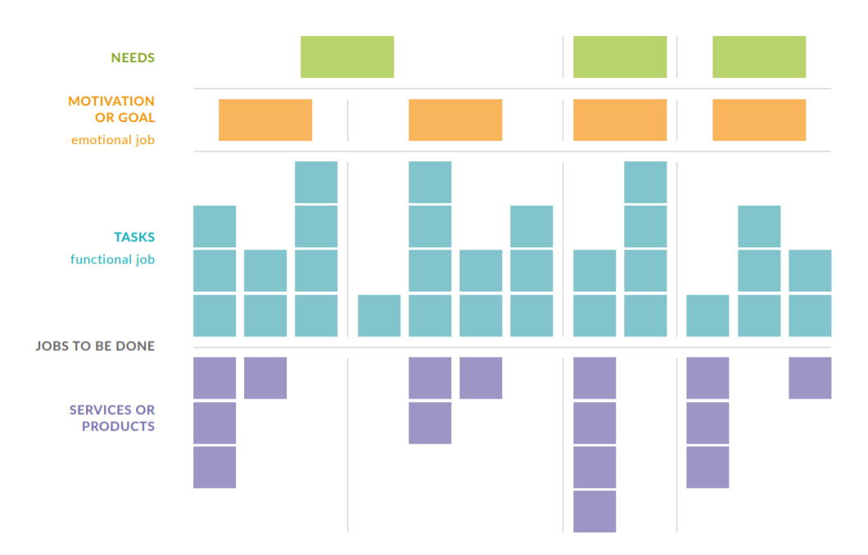
Story map
https://drawio-app.com/wp-content/uploads/2018/10/drawio-jobs-to-be-done-white-paper.pdf
At least these levels:
<persona goal/motivation>
<persona task>
---------
<product feature>
<story names w/ link>
Work products:
Draw.io / Miro / VP (skyline)
Structured text (.md) (stories)

Slide 6
Use case diagram
(take from the previous task)
Show main and alternative scenarios on a diagram
Provide a link to structured textual use case scenarios in your project repo.

Slide 7
Interaction analysis
Show a cooperation on a diagram along with the use case
OR. Show as a table, columns: use case - cooperation name - used roles - candidate classes that play them

Slide 8
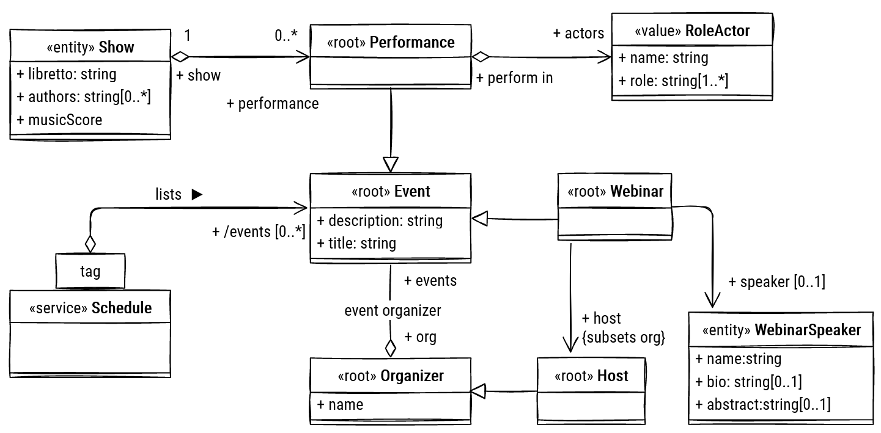
Final class diagram
The final class model should be consistent (well-formed) with interactions and use cases / stories.
Check that DDD stereotypes are set

Slide 9
Detailed behavior
Use an activity or state diagram to describe behavior of one of the dynamic classifiers in your model
Add the diagram here and explain how it works precisely in detail
Check that the overall model remains well-formed
Note: too small models may not be enough to demonstrate your qualification

Slide 10
Repository structure
Add a repo screenshot showing work products and documents from previous tasks
Demonstrate and explain how did you use tools from Task 2
Check that your project results are accessible for all course students (you may make a copy of your repo)

Slide 11
Team and roles
State team member roles along with photos and full names and primary contact (tg or email)

Slide 12
Roles
ML Engineer
Description: This role joins professionals involved in the development, deployment, and monitoring of ML models. They want to simplify the deployment process, automate API documentation, and ensure efficient request validation and caching, ultimately enhancing their workflow and model performance.
API Consumer
Description: This role includes all users interacting with APIs to integrate ML models into their applications. They want to access reliable and well-documented APIs, enabling seamless integration of ML models into their business applications and ensuring optimal performance and usability.

Slide 13
Personas
ML Engineer (Maria, 32 years old)
Goals:
Deploy and version ML models in Kubernetes.
Automatic API documentation and request validation.
Flexibility for different ML frameworks.
Pain points:
Manual API documentation.
Difficulties in monitoring model performance.
Backend Developer (Alexander, 28 years old)
Goals:
Use automatic OpenAPI schema generation.
Easily add API endpoints with request validation and security.
Pain points:
Manual API documentation.
Challenges with integrating authorization and managing access control.

Slide 14
Personas
API Consumer (Sergey, 30 years old)
Goals:
Get documentation for quick access to ML models.
Work with reliable and validated APIs.
Pain points:
Incomplete or outdated documentation.
API instability and delays.
Corporate Client (Yandex, Sber)
Goals:
Scalable and secure deployment of ML models.
Integration of the API gateway into existing infrastructure.
Pain points:
Challenges with integration and corporate standards.

Slide 15
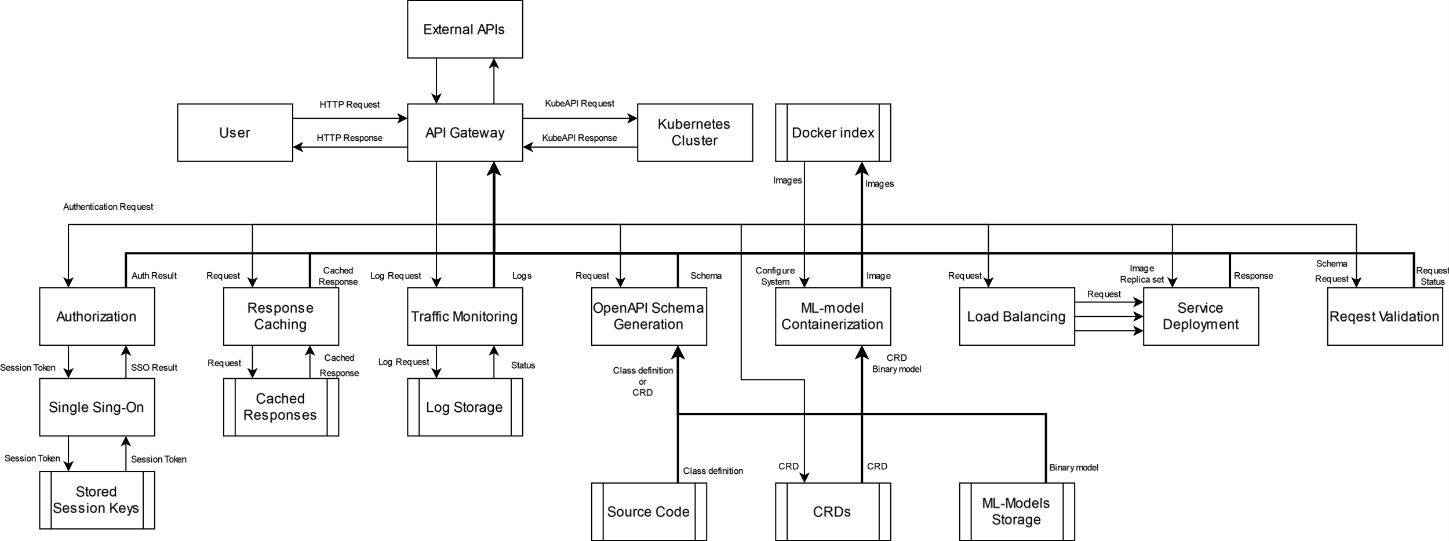
DFD (Level 0)

Slide 16
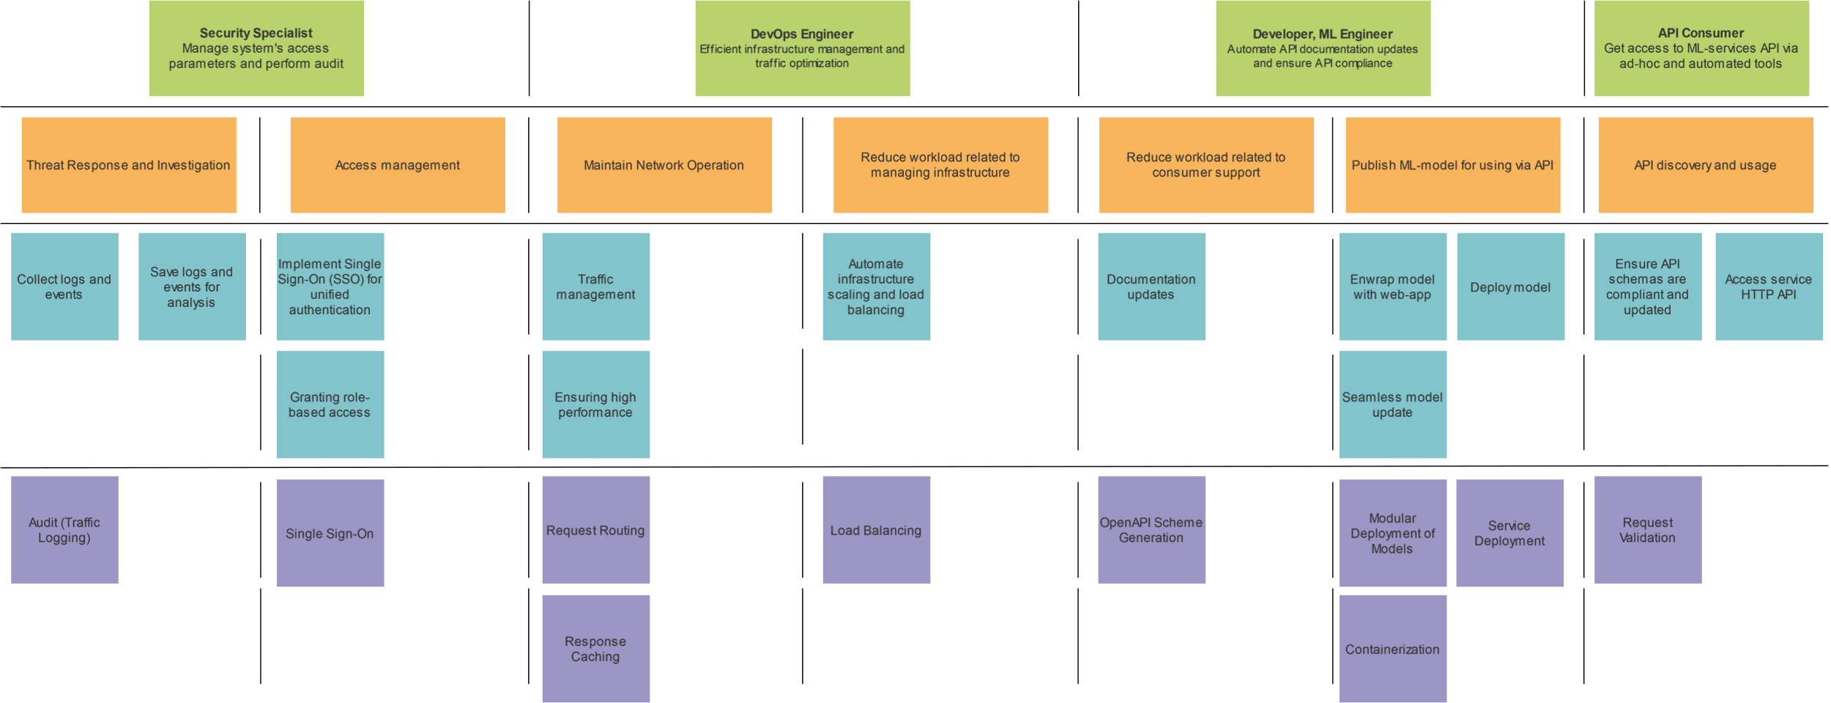
Story map

